Slide 1
Activity 2: FOURIER TRANSFORM MODEL OF IMAGE FORMATION PART 1
Genesis Vertudez – 202003099
App Physics 157 - Computational Analysis and Modeling in Physics
Submitted to Dr. Maricor Soriano; Mx. Rene Principe Jr.

Slide 2
OBJECTIVES
Use Fourier transform to manipulate images
Convolve images with patterns to apply it to them
Convolve images with filters to improve them
Use Fourier transform to locate certain patterns in images

Slide 3
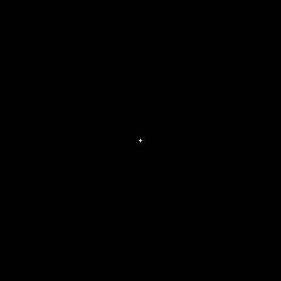





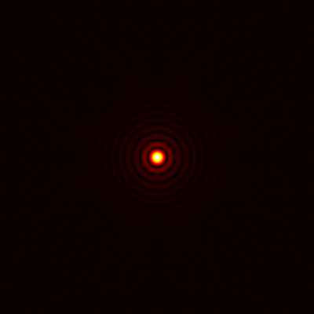
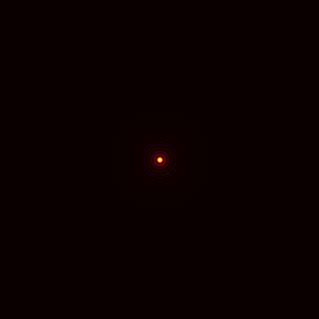
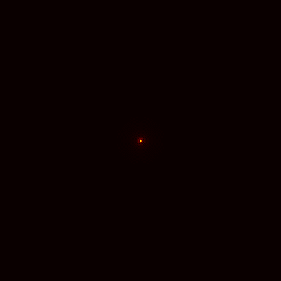
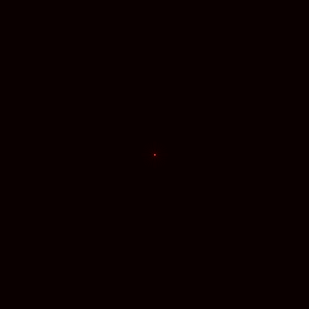
DISCRETE FOURIER TRANSFORM
Fourier transform of circles
The Fourier transform of a circle are concentric circles. The larger the radius of the circle, the smaller the Fourier transform.
Codes and files: https://github.com/genvert/AP_157_FX-2_Vertudez/tree/main/Activity%202

Slide 4

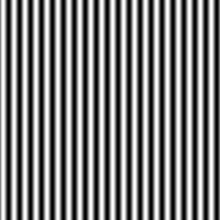
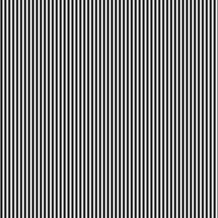
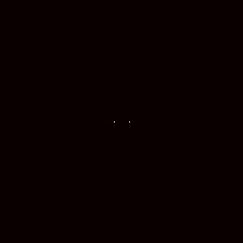
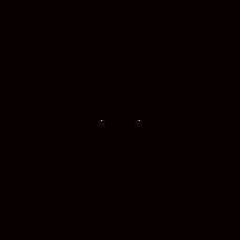

DISCRETE FOURIER TRANSFORM
Fourier transform of sinusoids
The Fourier transform of a sinusoid are two points, which correspond to two Dirac deltas. The frequency is directly proportional to the separation distance of the points.
Codes and files: https://github.com/genvert/AP_157_FX-2_Vertudez/tree/main/Activity%202

Slide 5
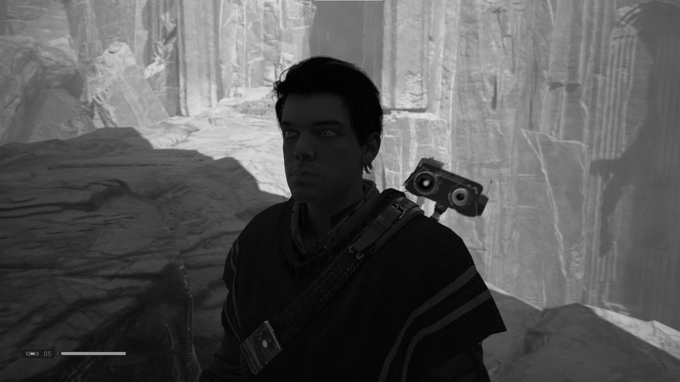
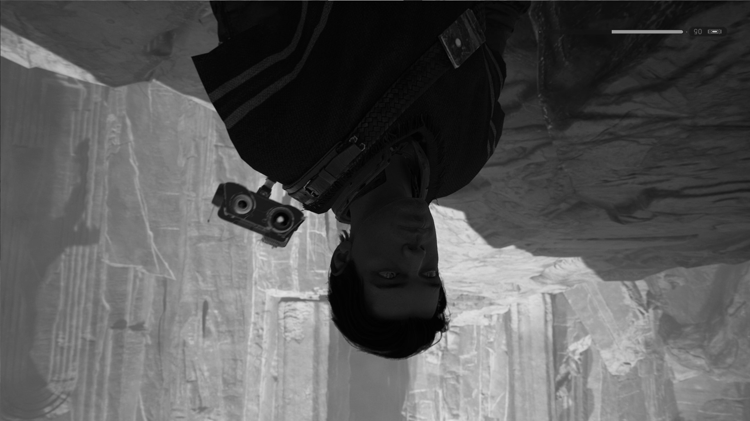

DISCRETE FOURIER TRANSFORM
fft of fft VS. ifft of fft
Original image fft of fft ifft of fft
Taking the fft of fft of an image rotates it 180 degrees.
Taking the ifft of fft returns the original image, which makes sense since they are inverse operator of each other.
Codes and files: https://github.com/genvert/AP_157_FX-2_Vertudez/tree/main/Activity%202

Slide 6





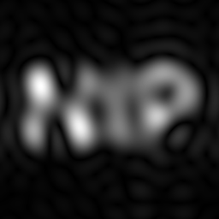
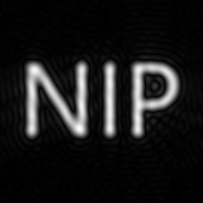
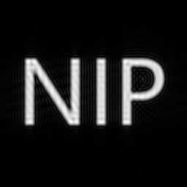



CONVOLUTION
Convolving an image with another
Convolving two functions is equal to multiplying their Fourier transforms
In this case, each pixel of the image acts as a Dirac delta function. Convolving it with different images (circles and sinusoid) essentially copies their the Fourier transform to each pixel.
From previous results, smaller circle has larger diffraction pattern as Fourier transform, which makes the NIP image blurry. Sinusoids has two points spaced from the center as Fourier transform, which makes the NIP image duplicate with space from the center.
Codes and files: https://github.com/genvert/AP_157_FX-2_Vertudez/tree/main/Activity%202

Slide 7
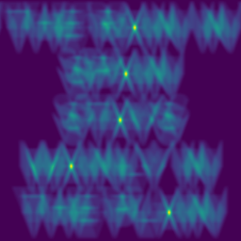
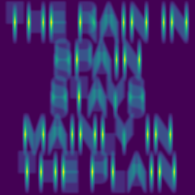
CONVOLUTION
Correlating an image with another
Correlating two functions is equal to multiplying their Fourier transforms, but this time the other is complex conjugate.
Correlation measures the degree of similarity of the functions
The results make sense since when the phrase was correlated with a letter, the result show the points where the functions (in this case images) are similar
Codes and files: https://github.com/genvert/AP_157_FX-2_Vertudez/tree/main/Activity%202

Slide 8
REFLECTION
This activity was straightforward, so I was able to follow it easily.
The applications of Fourier transform in images was actually fun and helped me strengthen my knowledge on Fourier analysis.
It is cool that the pixels can act as Dirac delta functions such that other images are copied to each pixel when convolved.
I’m just happy that I got to do this activity on time.

Slide 9
SELF-GRADE
Technical correctness: 35/35
I am confident that I understood how the Fourier transform of an image works and how to apply them in image processing.
Quality of presentation: 35/35
I have explained each step and idea, and images are clear and concise.
Self-reflection: 30/30
This activity was fun and it was the first activity that I managed to do on time.
Initiative: 10/10
I went beyond the expected output.

Slide 10
REFERENCES
[1] Soriano, M. (2023). AP 157 module. FT in Image Processing Part1.
[2] Cal Kestis screenshot. Star Wars Jedi: Fallen Order (2019).

